Slide 1
Space Health and Medicine: Psychological, Physiological and Behavioral stress
Genesis(Team-7)

Slide 2
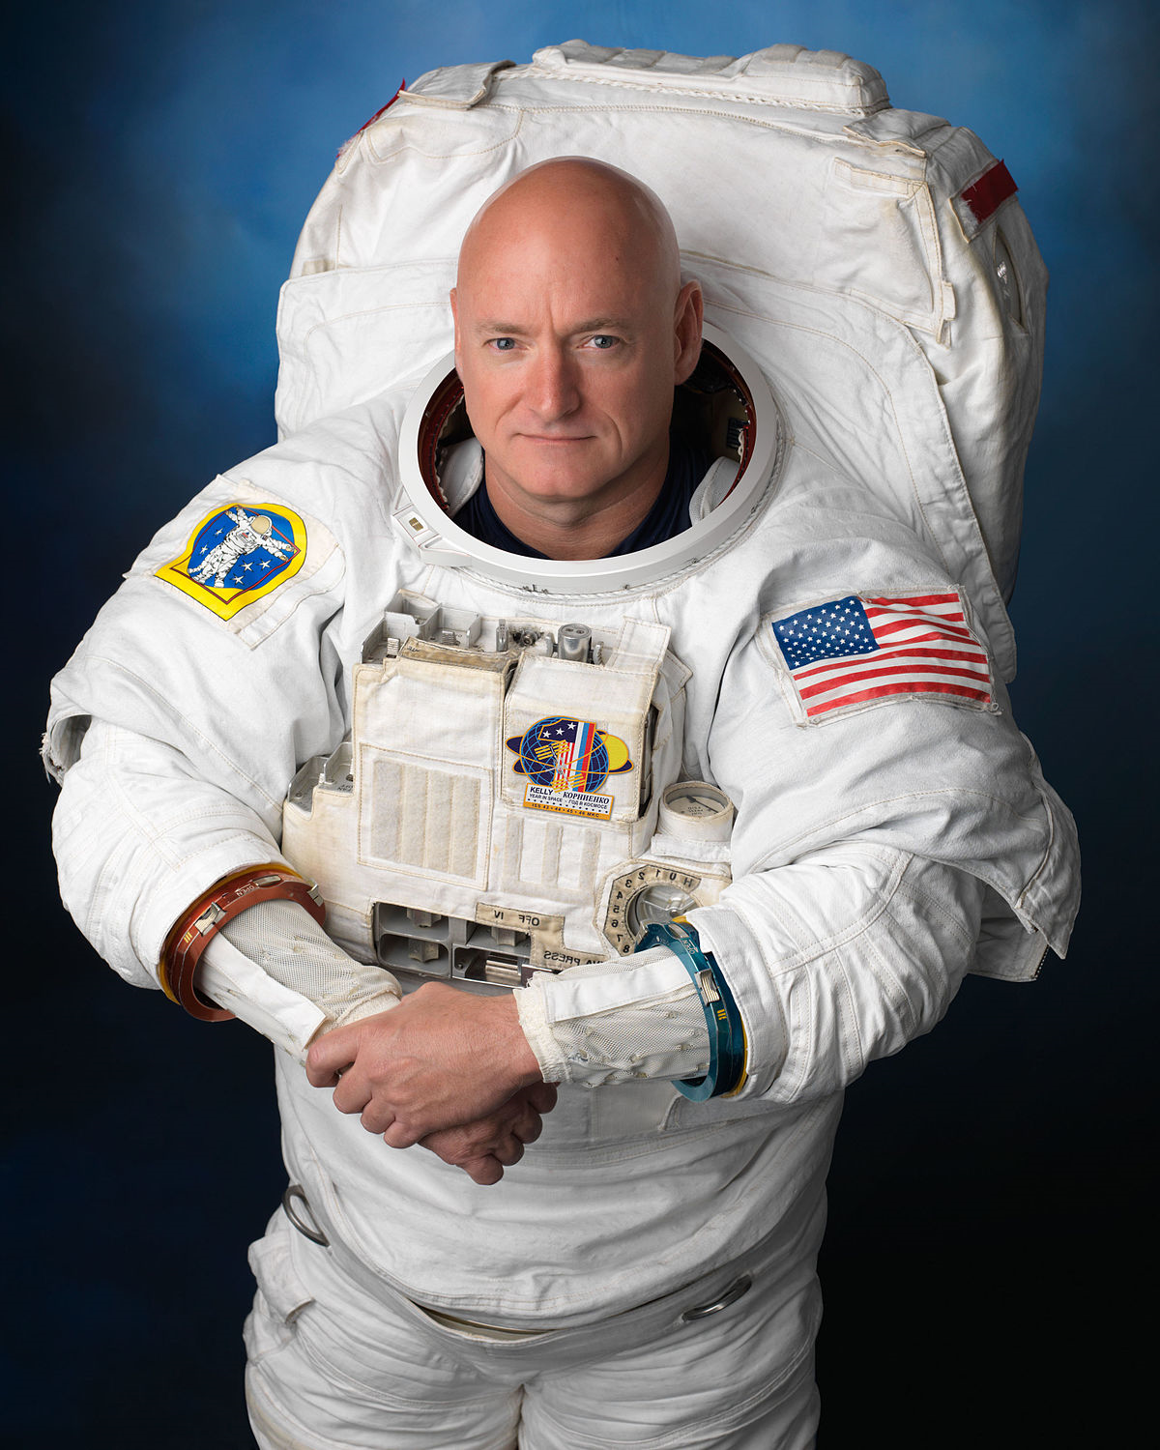
Motivation & Resources
Our Team has decided to work on this problem statement after reading about Scott Kelly who spent nearly a year on the International Space Station.
Scott Kelly's one-year mission was to better understand how the human body adapts to lengthy periods in space.
https://www.nasa.gov/sites/default/files/atoms/files/kellysj.pdf

Slide 3
What is our Goal?
To present report & analysis for :
Effects on Psychological & Behavioral health
Effects on Physical Health

Slide 4
Challenges for the Space Health
Effects on Psychological & Behavioral health
Psycho social stressors
Insomnia & Sleep
Circadian Rhythm
Duration of space travel

Slide 5
Psycho social stressors
Psychosocial stress affects most of space travelers and astronauts from time to time and can take a significant toll. It is the result of a cognitive appraisal (your mental interpretation) of what is at stake and what can be done about it. More simply put, psychosocial stress results when we look at a perceived social threat in our lives (real or even imagined) and discern that it may require resources we don't have.

Slide 6
Insomnia & Sleep

Slide 7
Circadian Rhythm
A circadian rhythm is a natural, internal process that regulates the sleep-wake cycle and repeats on each rotation of the Earth roughly every 24 hours. It can refer to any biological process that displays an endogenous, entrain able oscillation of about 24 hours.

Slide 8
Physical factors that influence nature
Life evolved on earth while the force of gravity has been constant for 4.8 billion years.
Therefore, there is little or no genetic memory of life responding to gravitational force changes.
As we transition terrestrial life to low gravity environments and study the adaptive processes in cells, our understanding of the role of gravity in shaping evolution on Earth will increase.
The response of higher organisms to this ‘new’ environment may be less ordered than the response to say, thermal change.

Slide 9
What happens to humans in space?
Early response (<3 weeks)
Cephalad fluid shift
Neurovestibular disturbances
Sleep disturbances
Bone demineralization
Intermediate (3 weeks to 6 months)
Radiation exposure
Bone resorption
Muscle atrophy
Cardiovascular deconditioning
GI disturbances
Hematological changes
Long Duration (6 months to 3 years)
Radiation exposure
Muscle atrophy
Cardiovascular deconditioning
GI disturbances
Hematological changes
Declining immunity

Slide 10
Health Effects on Physical Body due to micro-gravity

Slide 11
More than half of astronauts experience Space Adaptation Syndrome (SAS) commonly referred to as space sickness. SAS is a result of the human body suffering from spatial disorientation due to the transition into weightlessness. The vestibular system in the inner ear becomes confused by the lack of gravity, and the lack of a defined up and down. The effects can vary from mild nausea and discomfort to vomiting and intense headaches

Slide 12
EYE PROBLEMS : Conditions called as 'visual impairment intracranial pressure' syndrome, or VIIP, and the leading hypothesis is it's being caused by the lack of gravity causing pressure to build up in astronauts' head.
On Earth, gravity pulls fluid towards our feet, but in space, that doesn't happen they tend to move up to the skull due to micro-gravity.
All of this extra fluid in the skull could be putting pressure on the back of the eyeballs, causing them to flatten, and pushing the retinas forward to distort vision - at least that's what scientists think is happening.
The problem is that while scans have confirmed the eye-flattening part of things, the only way to monitor intracranial pressure is to perform a spinal tap or drill a hole in someone's head - both options that aren't ideal in space.

Slide 13
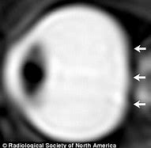
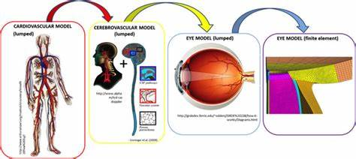

Slide 14
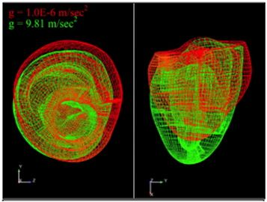
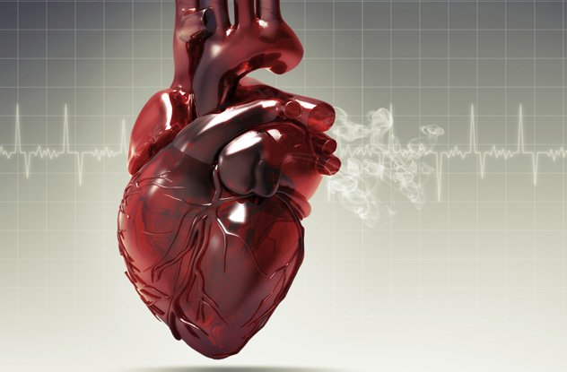
Cardiac Problems
When astronauts spend long periods of time at zero gravity in space, their hearts become more spherical and lose muscle mass, a new study finds, which could lead to cardiac problems. The spherical shape of the heart could mean the heart is functioning less efficiently. The condition appears to be temporary — the astronauts' hearts returned to a normal elongated shape after they return to Earth.

Slide 15
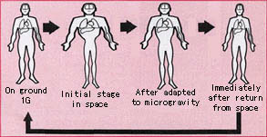
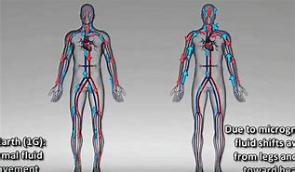
Puffy Faces and Skinny Legs
Puffy face and skinny leg syndrome is something that is experienced when living in space. This is a result of fluid changes in the body, especially within the first couple of days of entering the microgravity environment. On Earth the heart has to pump blood against gravity, to get blood to the upper half of your body it must work harder. In space there is no gravity to pull fluids down, they remain in the upper half of the body causing puffy face and skinny leg syndrome until the body readjusts.

Slide 16
Muscle Atrophy
Living and working in space is mentally strenuous. But the absence of gravity makes working in a spacecraft physically undemanding. On Earth, we must constantly use certain muscles to support ourselves against the force of gravity. These muscles, commonly called antigravity muscles, include the calf muscles, the quadriceps and the muscles of the back and neck. Because astronauts work in a weightless environment, very little muscle contraction is needed to support their bodies or move around. Without regular use and exercise our muscles weaken and deteriorate. It’s a process called atrophy. Studies have shown that astronauts experience up to a 20 percent loss of muscle mass on spaceflights lasting five to 11 days. The loss of muscle mass means a loss of strength that can be potentially dangerous if an astronaut must perform a strenuous emergency procedure upon re-entry into the Earth's gravitational field. Even though muscle mass and strength can be regained once astronauts have returned to Earth, maintaining muscle in space is a concern, especially for long-duration space missions. The only way to minimize muscle atrophy in space is through intensive exercise, particularly strength training exercises, combined with an adequate diet. Astronauts on the International Space Station spend 2 1/2 hours per day exercising to combat the effects of muscle atrophy.

Slide 17
Health Effects on Physical Body due to Stellar Radiations

Slide 18
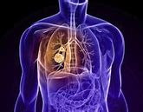
Problems in lungs due to cosmic dust
The most dangerous effect may be on the lungs if the fine particulates of moon dust are inhaled. Extremely sharp-edged moon dust can harm the heart and lungs, with effects ranging from inflammation to a heightened risk of cancer. It’s somewhat like inhaling asbestos.
This sharp-edged dust can also cause irritation and abrasions on skin. In fact, it’s been known to wear through multiple layers on a boot of Kevlar-like material. Lunar dust can also scratch the cornea of an astronaut’s eye, causing an especially serious emergency in space.

Slide 19
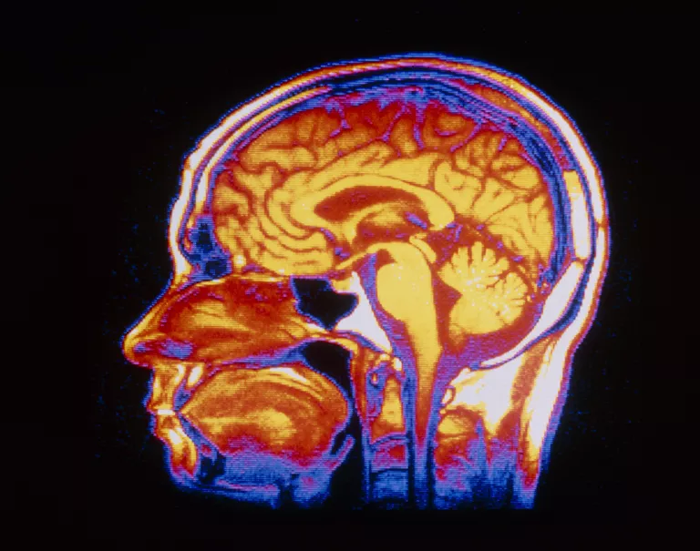
Cognitive problems due to stellar radiations
When simulating deep space conditions, scientists discovered that exposure to high-energy particles, even in low doses. biological marker to predict which astronauts will experience these effects. Then they might be able to lessen the effects of radiation for those people.
A more serious concern is Alzheimer’s. “Exposure to radiation levels equivalent to a mission to Mars could produce cognitive problems and speed up changes in the brain that are associated with Alzheimer’s disease

Slide 20
Sensors

Slide 21
Gamma Radiation Sensor
Exposure to nuclear radiations is extremely harmful to human and animal life. Three main types of nuclear radiations are alpha, beta, and gamma. Gamma radiation is dangerous to human life causing cellular destruction and subsequently leading to DNA damage, cancer, and radiation sickness if exposed in excess. Gamma radiation detector forms the heart of a radiation monitoring system and hence, deployment of such detectors in the vicinity of nuclear power plants is vital.

Slide 22


Slide 23
Body temperature sensor
The MAX30205 temperature sensor accurately measures temperature and provide an overtemperature alarm/ interrupt/shutdown output. This device converts the temperature measurements to digital form using a high resolution, sigma-delta, analog-to-digital converter (ADC). Accuracy meets clinical thermometry specification of the ASTM E1112 when soldered on the final PCB. Communication is through an I2C-compatible, 2-wire serial interface.

Slide 24
Benefits and Features
High Accuracy and Low-Voltage Operation Aids Designers in Meeting Error and Power Budgets
0.1°C Accuracy (37°C to 39°C)
16-Bit (0.00390625°C) Temperature Resolution
2.7V to 3.3V Supply Voltage Range
One-Shot and Shutdown Modes Help Reduce Power Usage
600μA (typ) Operating Supply Current
Digital Functions Make Integration Easier into Any System • Selectable Timeout Prevents Bus Lockup • Separate Open-Drain OS Output Operates as Interrupt or Comparator/Thermostat Output

Slide 25
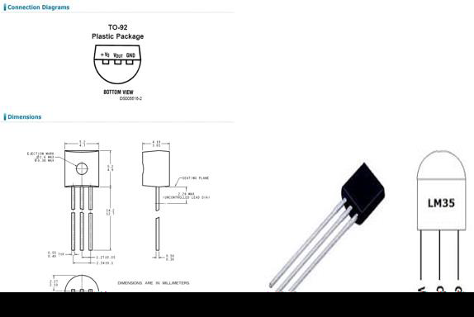
Technical Specifications
Calibrated directly in Celsius (Centigrade)
Linear + 10-mV/°C scale factor
0.5°C ensured accuracy (at 25°C)
Rated for full −55°C to 150°C range
Suitable for remote applications

Slide 26
Pulse Rate Sensor
The heartbeat sensor is based on the principle of photoplethysmography. It measures the change in volume of blood through any organ of the body which causes a change in the light intensity through that organ (avascular region). In the case of applications where the heart pulse rate is to be monitored, the timing of the pulses is more important. The flow of blood volume is decided by the rate of heart pulses and since light is absorbed by the blood, the signal pulses are equivalent to the heartbeat pulses.
There are two types of photoplethysmography:
Transmission: Light emitted from the light-emitting device is transmitted through any vascular region of the body like earlobe and received by the detector.
Reflection: Light emitted from the light-emitting device is reflected by the regions.

Slide 27
Working of a Pulse rate sensor
The basic heartbeat sensor consists of a light-emitting diode and a detector like a light detecting resistor or a photodiode. The heartbeat pulses cause a variation in the flow of blood to different regions of the body. When tissue is illuminated with the light source, i.e. light emitted by the led, it either reflects (a finger tissue) or transmits the light (earlobe). Some of the light is absorbed by the blood and the transmitted or the reflected light is received by the light detector. The amount of light absorbed depends on the blood volume in that tissue. The detector output is in the form of the electrical signal and is proportional to the heartbeat rate.
This signal is a DC signal relating to the tissues and the blood volume and the AC component synchronous with the heartbeat and caused by pulsatile changes in arterial blood volume is superimposed on the DC signal. Thus the major requirement is to isolate that AC component as it is of prime importance.

Slide 28
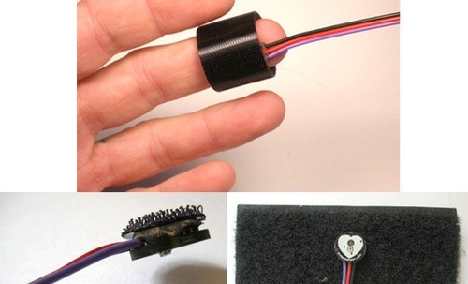
Pulse rate sensor

Slide 29
GSR Sensor
GSR stands for galvanic skin response, is a method of measuring the electrical conductance of the skin. Strong emotion can cause stimulus to your sympathetic nervous system, resulting more sweat being secreted by the sweat glands. Grove - GSR allows you to spot such strong emotions by simple attaching two electrodes to two fingers on one hand. It is an interesting to create emotion related projects like sleep quality monitor.

Slide 30
